Slide 1
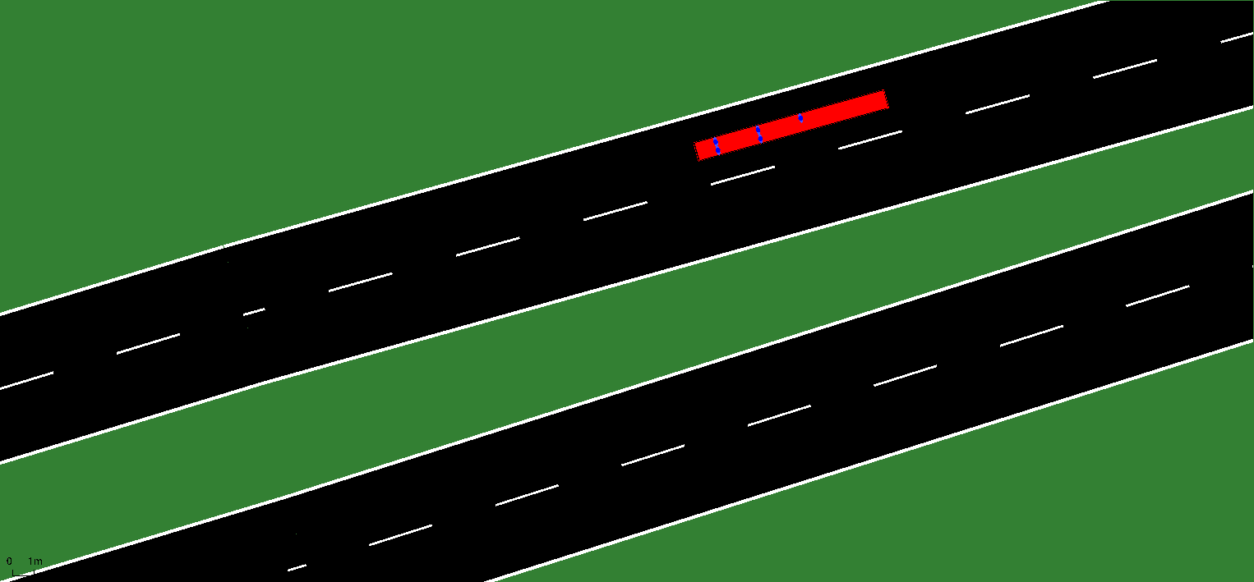
ELCA challenge, Polyhack 2020
Team SelfDrivingAIBlockchain

Slide 2
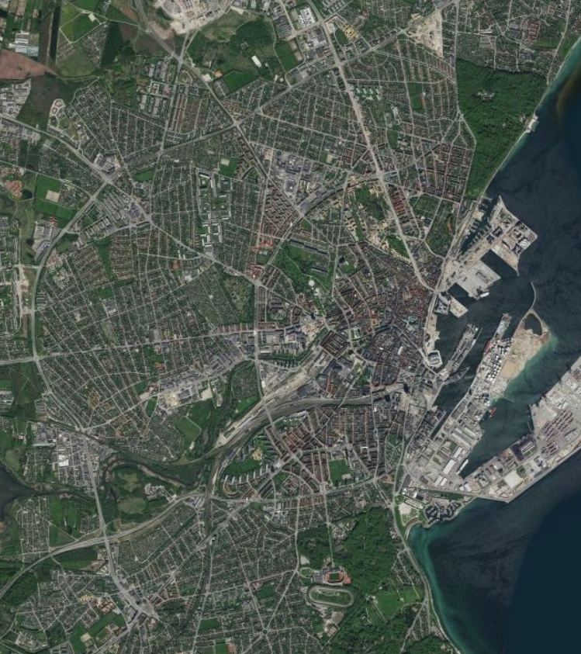
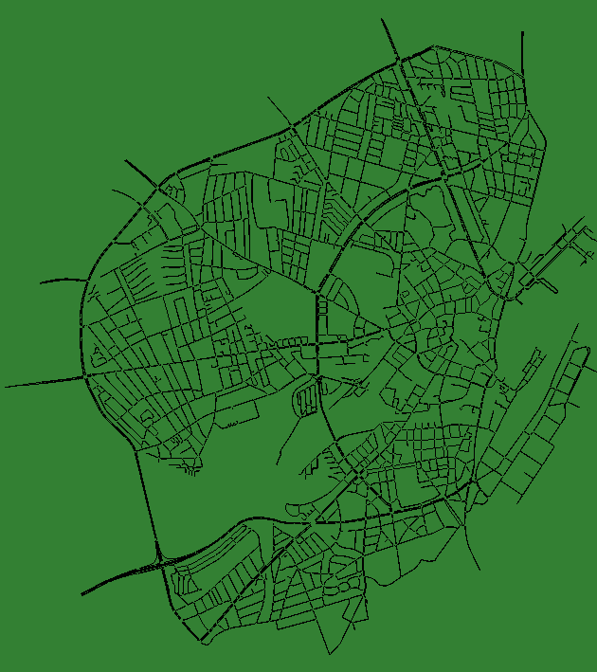
Introduction

Slide 3
Aarhus
Real city streets

Slide 4
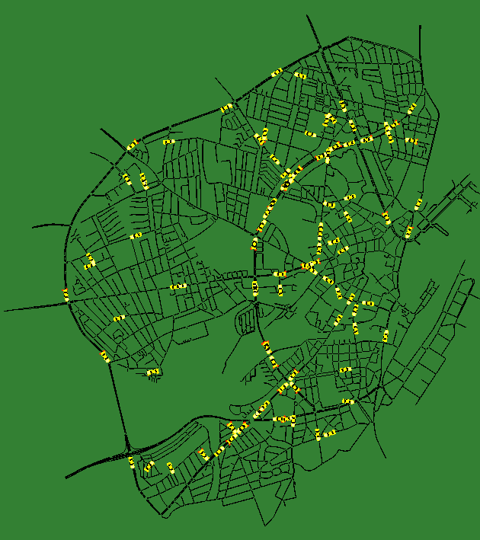
Aarhus
Real city streets
Simulated traffic data (yellow)

Slide 5
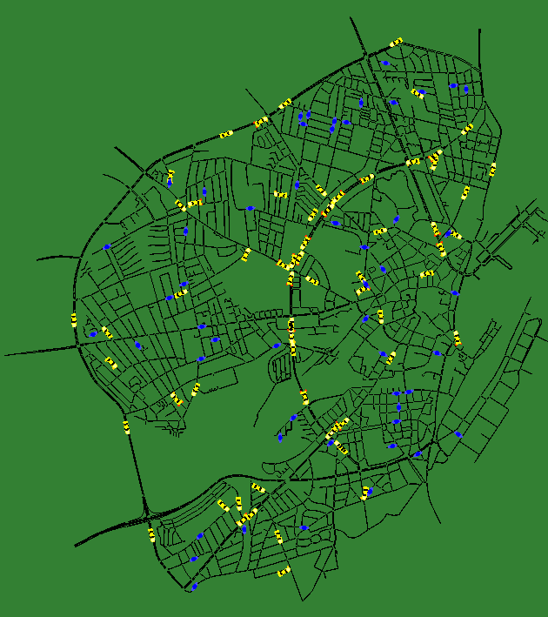
Aarhus
Real city streets
Simulated traffic data (yellow)
Pedestrians generated at random locations (blue)
Challenge: route buses to bring them to their destination

Slide 6
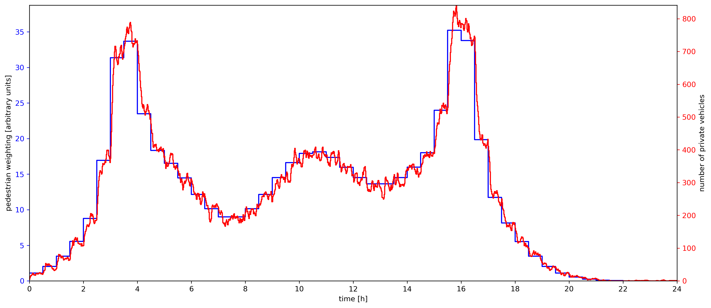
Evolution of traffic throughout the day

Slide 7
Evolution of traffic throughout the day
The number of new pedestrians spawned is proportional to the blue curve
The number of background vehicles (not buses) is given by the red curve
Congestion is expected because both coincide
Performance of the bus network has to be good according to the defined challenge metrics in very different situations (rush hour vs. night)
Flexible bus routing algorithm is needed

Slide 8
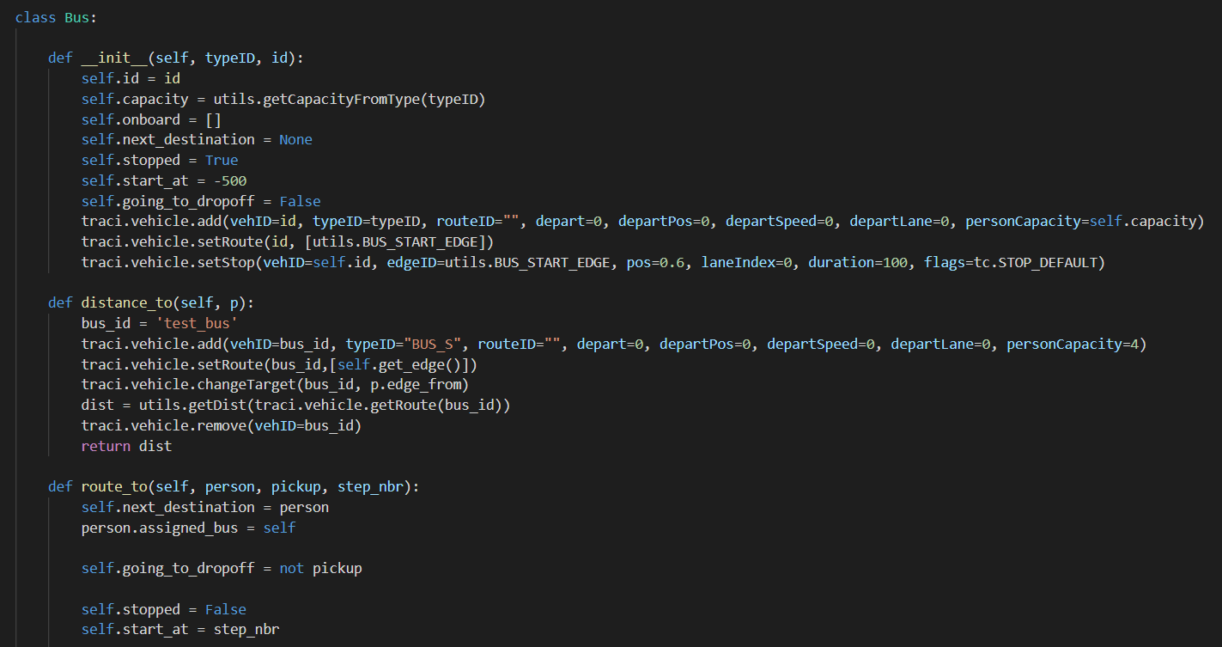
Implementation Overview

Slide 9
Class based program structure
Object oriented programming
Two main classes
Flexible structure allows for implementation of different routing algorithms into identical framework
Bus
Contains functions like
distance_to(edge)
select_next_target(candidates)
pickup
…
Director
Macro overview
Directs the buses

Slide 10
3 Events listener strategy
Only 3 events could reroute bus A:
New pedestrian appears
Director loops through bus instances and select the A as the closest bus. Only if the pedestrian would be the next pickup stop (maybe there is still a more advantageous pickup to do first)
A Picks up pedestrian
A Drops off pedestrian
For these 2 cases, the bus choses the closest among, dropping someone off, or picking someone up if not already full

Slide 11
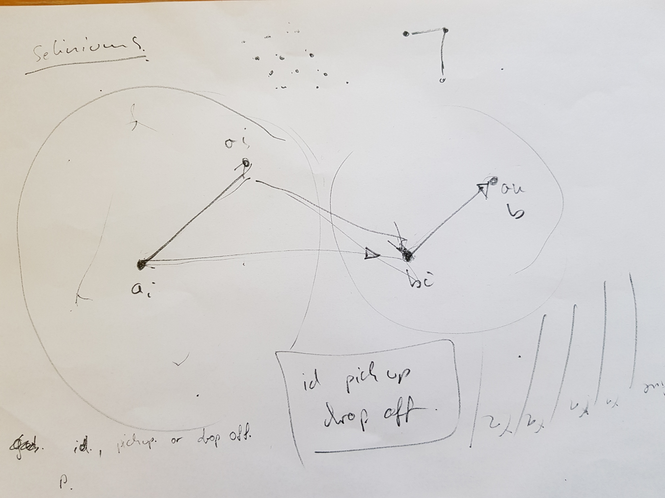
Possible Extensions/
Strategies

Slide 12
Additional strategies to be implemented
Notation:
Let x, y be edges on the map
Metric: d(a,b) = estimated time from a to b
Let P_i be a passanger going from a_i to b_i.
Remarks
Too expensive to calculate the global optimum for many P_i.
Hence we assume that each bus being efficent on a local scale gives us some gobal minimum.

Slide 13
Pre processing
We sort out the “trivial” cases for all further models that is a full bus is going to drop of a Person at the closest destination or an empty bus is going to pick up the nearest person.
Hence for the following strategies we assume the Bus has some destination but is not full.

Slide 14
Strategy 1
This describes the strategy for one bus but they all behave the same way.
We first take a Ball B={ a_i | dist(bus.position, a=i) <c } around the current bus position. This is our local selection of possible people to include in the local optimization. Here c is some constant and a parameter to fine tune the model.
For any bus define X this is the union of B and all the {b_i | P_i is a passenger in the Bus}. Hence X are all the edges the Bus could go to and preform either picking up or dropping off a passenger.

Slide 15
Strategy 1
We make after any action (drop off, pick up, new person appears) the following choice. Let B be the bus location.
a_k
We first calculate the initial cost that is: going from the bus edge to the current destination x in X and then to the closest y in X\{x}.
Init_cost=dist(B,x)+dist(x,y)
Indicated by the path in red
a_i
B
x
y
a_l

Slide 16
Strategy 1
Now we calculate for evey a_i in the Ball
d_i=d(B,a_i)+d(a_i,x)
i=argmin([d_i])
If d_i<initial_cost
set new route to pick up a_i
Otherwise keep going to x
So we check if it is faster to pick up somebody and still go to x or to just go to x and to the next stop. If we decide to reroute to a_i we forget that we wanted to go to x before.
Ball B
a_k
a_i
B
x
y
a_l

Slide 17
Strategy 1
Advantage of this method it only has to call the distance function 2 tímes per a_i. So computational cost is linear.
We use the property of the Set X and are taking into account potential new a_i
Hence minimizing the new waiting time.
We made the underlying assumption that due to the fact we are driving in a city the minimal waiting time is highly correlated with less km driven. Hence this also optimizes the distance covered.
The model can be expended by adding penalty terms to d_i

Slide 18
Strategy 2
Here we have n busses and for each Bus we have a set X_i containing all the a`s the bus wants to pick up and the b`s to drop off.
Without loss of generality we assume no two people appear at the same time (in that case we choose one random first).
Also each bus is on its optimal route with respect to X. And it takes Time T(X). This is the cumulated waiting time for all people in X.
When a new person appears we compare what the extra detour time is for every bus compared just working through X.

Slide 19
Strategy 2
New Passenger P with a and b
a
Example with 3 Buses. Here it is the easiest for Bus 2 to include P to his route. That is Adding {a,b} to X
New route
Bus 1
Bus 2
Bus 3
b
ΔT_1=T(X_1 U {a,b})-T(X_1)
ΔT_2=T(X_2 U {a,b})-T(X_2)
ΔT_3=T(X_3 U {a,b})-T(X_3)

Slide 20
Strategy 2
Then the bus with the smallest Δ is chosen and {a,b} added its list X.
It is left to define a optimal route for X. Here any algorithm A can be take which optimizes traveling salesmen problem with the constrain that is has to go to a_i first before going to b_i.
Hence the computational load can be adjusted by choosing A.

Slide 21
Strategy
This approach also minimizes the waiting time but with respect to all passengers hence should yield a better global solution.
Based on the algorithm A it is very flexible and can be applied to optimize existing single Bus strategies.

Slide 22
Conclusion
The bug in the release version of SUMO cost us a lot of time
Pair programming is fun, the night was long
Having strong modular code helps debugging, think in an abstract manner. Even in such a small timeframe!
Thanks for the challenge!

